Slide 1
Handling missing data

Slide 2
MISSING DATA
Missing data are observations that are not there for many reasons
Missing data can occur for many reasons:
participants can fail to respond to questions (legitimately or illegitimately—more on that later),
equipment and data collecting or recording mechanisms can malfunction,
subjects can withdraw from studies before they are completed, and
data entry errors can occur.
When we have missing data, our goal remains the same with what it was if have the complete data. So, the analysis are now more complex.

Slide 3
Missingness Mechanism
Before starting any analysis with incomplete data, we have to clarify the nature of missingness mechanism which causes some values being missing. Previously, there was common belief that the mechanism was random but it was really as it was thought?
Generally, there are two notions accepted for missingness mechanism by all researchers: ignorable and non-ignorable missingness mechanism.
If the mechanism is ignorable we don’t have to care about it and we can ignore it confidently before missing data analysis but if it is not we have to model the mechanism also as part of the parameter estimation.
Identifying the missingness mechanism with a statistical approach is still being a tough problem and so try to develop some diagnostic procedure on missingness mechanism is an important research topic.

Slide 7
Missingness Mechanism
Rubin (1976) specified three types of assumptions on missingness mechanism:
Missing Completely at Random (MCAR)
Missing at Random (MAR)
Missing Not at Random (MNAR).
MCAR and MAR are in class of ignorable missingness mechanism but MNAR is in class of non-ignorable mechanism.
MCAR assumption is generally difficult to meet in reality and it assumes that there is no statistically significant difference between incomplete and complete cases. In other words, the observed data points can only be considered as a simple random sample of the variables you would have to analyze. It assumes that missingness is completely unrelated to the data (Enders, 2010). In this case, there is no impact of missingness affecting on the inferences. Little (1988) proposed a chi-square test for diagnosing MCAR mechanism so called Little’s MCAR test.

Slide 8



Missing data
Missing data is a common problem and challenge for analysts.
There are many reasons why data could be missing, including:
Respondents forgot to answer questions.
Respondents refused to answer certain questions.
Respondents failed to complete the survey.
A sensor failed.
Someone purposefully turned off recording equipment.
There was a power cut.
The method of data capture was changed.
An internet connection was lost.
A network went down.
A hard drive became corrupt.
A data transfer was cut short.

Slide 9

Missing data
Missing data can usually be classified into:
Missing Completely at Random (MCAR):
If missingness doesn’t depend on the values of the data set.
e.g. a random sample of patients who had their blood pressure measured also had their weight measured.
Missing at Random (MAR):
If missingness does not depend on the unobserved values of the data set but does depend on the observed.
e.g. patients with high blood pressure had their weight measured.
Not Missing at Random (NMAR):
If missingness depends on the unobserved values of the data set.
e.g. overweight patients had their weight measured.
Notes:
Another example:
MCAR: Survey questions asked only to a random sample of original sample.
MAR: Respondents in service occupations less likely to report income.
NMAR: Respondents with high income less likely to report income.
NMAR is difficult to analyse / complex

Slide 10
Missing data
Another example: Survey data on drug use.
Missing Completely at Random (MCAR):
You removed 10% of the respondents data randomly.
Missing at Random (MAR):
People who come from poorer families might be less inclined to answer questions about drug use, and so the level of drug use is related to family income.
Not Missing at Random (NMAR):
Students skipped the question on drug use because they feared that they would be expelled from school.
(most common type)

Slide 11
Missing data
Generally the procedure for dealing with missing data is:
Identify the missing data.
Identify the cause of the missing data.
Either:
Remove the rows containing the missing data
Also called the naïve approach.
Make sure missing data isn’t biased!
Replace missing values with alternative values.
Impute the missing values.
There are a number of approaches.
Deciding between A and B depends on which outcome you think will produce the most reliable and accurate results.

Slide 12
Missing Completely at Random (MCAR)
Missingness completely at random. A variable is missing completely at random if the probability of missingness is the same for all units, for example, if each survey respondent decides whether to answer the “earnings” question by rolling a die and refusing to answer if a “6” shows up.
If data are missing completely at random, then throwing out cases with missing data does not bias your inferences.

Slide 13
Missing at Random
A more general assumption, missing at random, is that the probability a variable is missing depends only on available information. Thus, if sex, race, education, and age are recorded for all the people in the survey, then “earnings” is missing at random if the probability of nonresponse to this question depends only on these other, fully recorded variables.
It is often reasonable to model this process as a logistic regression, where the outcome variable equals 1 for observed cases and 0 for missing.

Slide 14
Missing Not at Random
Finally, a particularly difficult situation arises when the probability of missingness depends on the (potentially missing) variable itself. For example, suppose that people with higher earnings are less likely to reveal them.
In the extreme case (for example, all persons earning more than $100,000 refuse to respond), this is called censoring, but even the probabilistic case causes difficulty.

Slide 15
Dealing with Missing Data
Use what you know about
Why data are missing
Distribution of missing data
Decide on the best analysis strategy to yield the least biased estimates

Slide 16
Deletion Methods
Delete all cases with incomplete data and conduct analysis using only complete cases.
Advantage: Simplicity
Disadvantage: loss of data if we discard all incomplete cases. So, in efficient
NOTE: If you use complete case analysis, then change summary statistics for other variables, too.

Slide 17
Example: n=19,p=4, only 15% missing values
Individual | Case 1 |  |  |  | Case 2 |  |  |  | Case 3
 | y₁ | y₂ | y₃ | y₄ | y₁ | y₂ | y₃ | y₄ | y₁ | y₂ | y₃ | y₄
1 | NA | NA | NA | NA | NA |  |  |  | NA
2 | NA | NA |  |  | NA |  |  |  | NA
3 |  |  |  |  | NA |  |  |  |  | NA
4 |  |  |  |  | NA |  |  |  |  | NA
5 |  |  |  |  | NA |  |  |  |  |  | NA
6 |  |  |  |  | NA |  |  |  |  |  | NA
7
8
9
10
Eliminate individual 1 and 2.
Keep 8*4=32 data. 20% loss
Eliminate variable 1.
Keep 10*3=30 data. 25% loss
Eliminate individual 1 -6.
Keep 4*4=16 data. 60% loss

Slide 18
Listwise Deletion (Complete case analysis)
Only analyze cases with available data on each variable
Advantage: simplicity and comparability across analyses
Disadvantage: reduces statistical power (due to sample size), not use all information, estimates may be biased if data not MCAR
Listwise deletion often produces unbiased regression slope estimates as long as missingness is not a function of outcome variable.

Slide 19
Pairwise Deletion (Available case analysis)
Analysis with all cases in which the variables of interest are present
Advantage: keeps as many cases as possible for each analysis, uses all information possible with each analysis
Disadvantage: cannot compare analyses because sample is different each time, sample size vary for each parameter estimation, can obtain nonsense results
Compute the summary statistics using n_{i} observations not n.
Compute correlation type statistics using complete pairs for both variables.

Slide 20
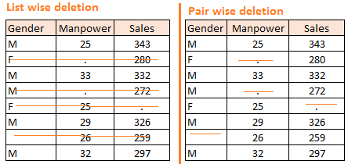
Example

Slide 21
Imputation Methods
1. Random sample from existing values:
You can randomly generate an integer from 1 to n-n_{missing}, then replace the missing value with the corresponding observation that you chose randomly
Case: 1 2 3 4 5 6 7 8 9 10
Y₁: 3.4 3.9 2.6 1.9 2.2 3.3 1.7 2.4 2.8 3.6
Y₂: 5.7 4.8 4.9 6.2 6.8 5.6 5.4 4.9 5.7 NA
Randomly generate number between 1 and 9: Say 3
Replace Y_{2,10} by Y_{2,3}=4.9
Disadvantage: It may change the distribution of data
4.9

Slide 22
Imputation Methods
2. Randomly sample from a reasonable distribution
e.g. If gender is missing and you have the information that there re about the sample number of females and males in the population.
Gender ~Ber(p=0.5) or estimate p from the observed sample
Using random number generator from Bernoulli distribution for p=0.5, generate numbers for missing gender data
Disadvantage: distributional assumption may not be reliable (or correct), even the assumption is correct, its representativeness is doubtful.

Slide 23
Imputation Methods
3. Mean/Mode Substitution
Replace missing value with the sample mean or mode. Then, run analyses as if all complete cases
Advantage: We can use complete case analyses
Disadvantage: Reduces variability, weakens the correlation estimates because it ignores the relationship between variables, it creates artificial band
Unless the proportion of missing data is low, do not use this method.

Slide 24
Last Observation Carried Forward
This method is specific to longitudinal data problems.
For each individual, NAs are replaced by the last observed value of that variable. Then, analyze data as if data were fully observed.
Disadvantage: The covariance structure and distribution change seriously
Observation time
Cases | 1 | 2 | 3 | 4 | 5 | 6
1 | 3.8 | 3.1 | 2.0 | NA | NA | NA
2 | 4.1 | 3.5 | 2.8 | 2.4 | 2.8 | 3.0
3 | 2.7 | 2.4 | 2.9 | 3.5 | NA | NA
2.0
2.0
2.0
3.5
3.5

Slide 25
Imputation Methods
4. Dummy variable adjustment
Create an indicator variable for missing value (1 for missing, 0 for observed)
Impute missing value to a constant (such as mean)
Include missing indicator in the regression
Advantage: Uses all information about missing observation
Disadvantage: Results in biased estimates, not theoretically driven

Slide 26
Imputation Methods
5. Regression imputation
Replace missing values with predicted score from regression equation. Use complete cases to regress the variable with incomplete data on the other complete variables.
Advantage: Uses information from the observed data, gives better results than previous ones
Disadvantage: over-estimates model fit and correlation estimates, weakens variance

Slide 27
Imputation Methods
5. Regression imputation
Replace missing values with predicted score from regression equation. Use complete cases to regress the variable with incomplete data on the other complete variables.
Advantage: Uses information from the observed data, gives better results than previous ones
Disadvantage: over-estimates model fit and correlation estimates, weakens variance

Slide 28
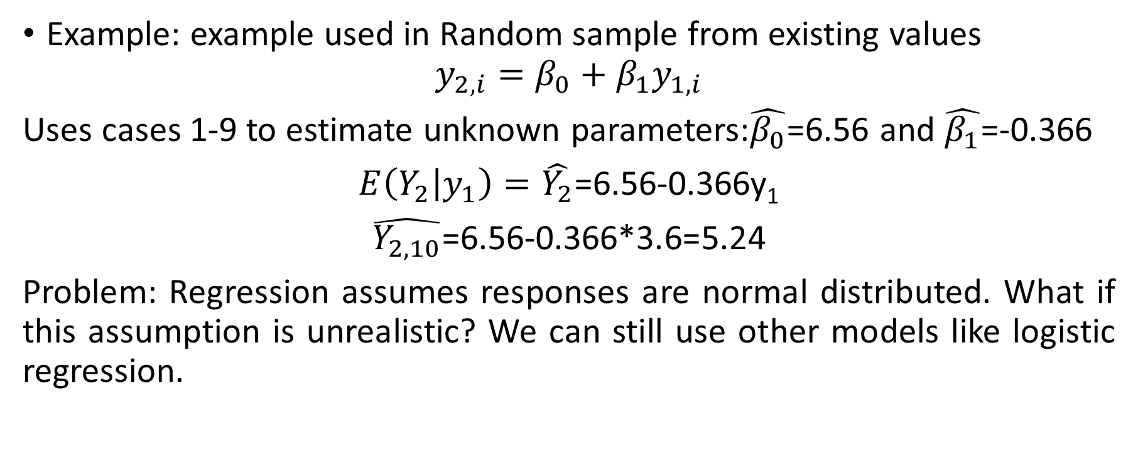
Imputation Methods

Slide 29
Imputation Methods
6. Maximum Likelihood Estimation
Identifies the set of parameter values that produces the highest log-likelihood.
ML estimate: value that is most likely to have resulted in the observed data.
Advantage: uses full information (both complete and incomplete) to calculate the log-likelihood, unbiased parameter estimates with MCAR/MAR data
Disadvantage: Standard errors biased downward but this can be adjusted by using observed information matrix.

Slide 30
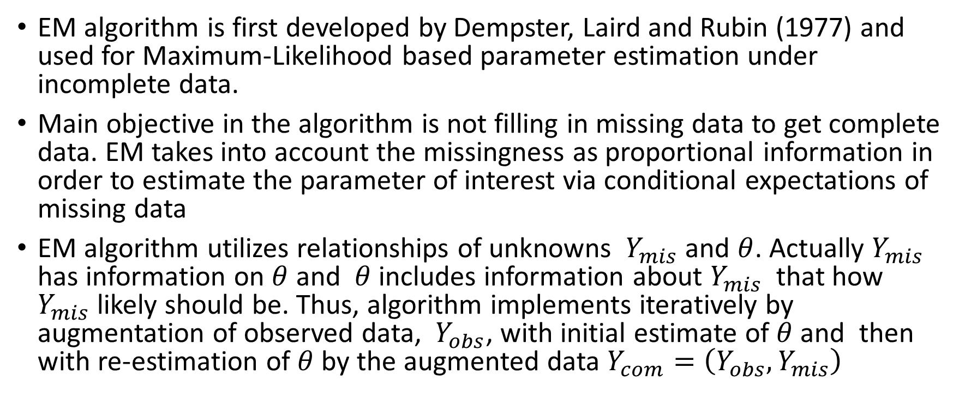
Imputation Methods

Slide 31
Multiple Imputation (MI)
Multiple imputation (MI) appears to be one of the most attractive methods for general- purpose handling of missing data in multivariate analysis. The basic idea, first proposed by Rubin (1977) and elaborated in his (1987) book, is quite simple:
Impute missing values using an appropriate model that incorporates random variation.
Do this M times producing M “complete” data sets.
Perform the desired analysis on each data set using standard complete-data methods.
Average the values of the parameter estimates across the M samples to produce a single point estimate.
Calculate the standard errors by (a) averaging the squared standard errors of the M estimates (b) calculating the variance of the M parameter estimates across samples, and (c) combining the two quantities using a simple formula

Slide 32
Multiple Imputation
Multiple imputation has several desirable features:
Introducing appropriate random error into the imputation process makes it possible to get approximately unbiased estimates of all parameters. No deterministic imputation method can do this in general settings.
Repeated imputation allows one to get good estimates of the standard errors. Single imputation methods don’t allow for the additional error introduced by imputation (without specialized software of very limited generality).

Slide 33
Multiple Imputation
With regards to the assumptions needed for MI,
First, the data must be missing at random (MAR), meaning that the probability of missing data on a particular variable Y can depend on other observed variables, but not on Y itself (controlling for the other observed variables).
Example: Data are MAR if the probability of missing income depends on marital status, but within each marital status, the probability of missing income does not depend on income; e.g. single people may be more likely to be missing data on income, but low income single people are no more likely to be missing income than are high income single people.
Second, the model used to generate the imputed values must be “correct” in some sense.
Third, the model used for the analysis must match up, in some sense, with the model used in the imputation

Slide 34
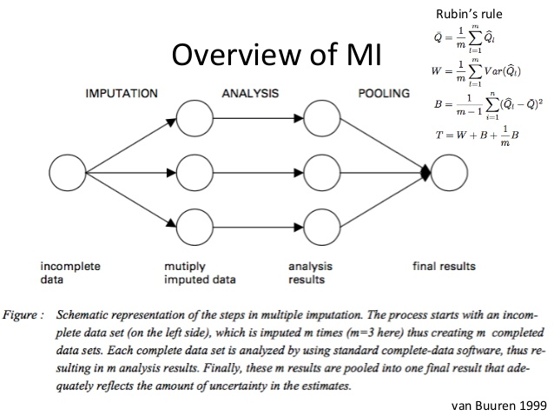
Multiple Imputation

Slide 35
EM-MCMC Multiple Imputation

